Slide 1


Network protocols & security
24EC2210
Topic:
Network hardware: Topologies
Session - 3

Slide 2



AIM OF THE SESSION
To familiarize students with the network topologies and different types of computer networks
INSTRUCTIONAL OBJECTIVES
This Session is designed to:
Demonstrate the network topologies
Describe the modes of data transmission.
LEARNING OUTCOMES
At the end of this session, you should be able to:
Define topology and describe the way how systems are connected using different topologies.
Summarize the modes of data transmission.

Slide 3
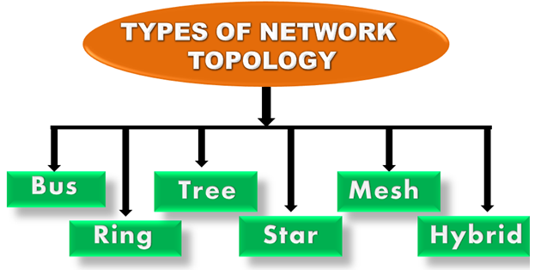
NETWORK TOPOLOGY
Topology defines the structure of the network of how all the components are interconnected to each other.

Slide 4
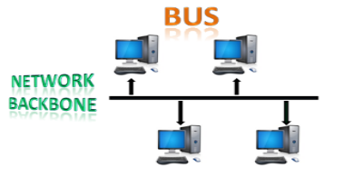
Network Topology..
Bus Topology:
The bus topology is designed in such a way that all the stations are connected through a single cable known as a backbone cable. The backbone cable is considered as a "single lane" through which the message is broadcast to all the stations.
When a node wants to send a message over the network, it puts a message over the network. All the stations available in the network will receive the message whether it has been addressed or not.

Slide 5
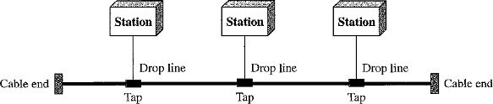
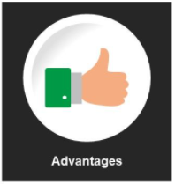
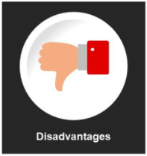
Nodes are connected to the bus cable by drop lines and taps.
A drop line is a connection running between the device and the main cable.
A tap is a connector that splices into (attached to) the main cable.
If the backbone cable fails, the entire system fails.
There is a limit on the number of taps a bus can support and on the distance between those taps.
More taps will generate more heat which degrades the quality of signal.
Installation is easy.
A bus uses less cabling than mesh or star topologies.

Slide 6
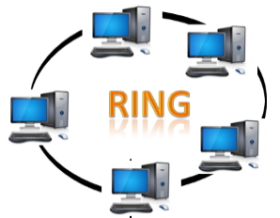
Network Topology..
Ring Topology:
Ring topology is like a bus topology, but with connected ends.
In a ring topology, each device has a dedicated point-to-point connection with only the two devices on either side of it.
The node that receives the message from the previous computer will retransmit to the next node.
A signal is passed along the ring in one direction(clockwise) from device to device, until it reaches its destination.

Slide 7
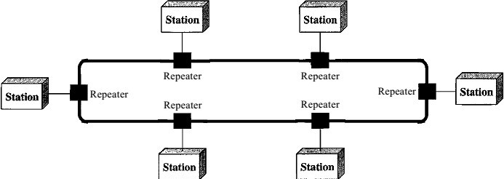
Each device in the ring incorporates a repeater.
When a device receives a signal intended for another device, its repeater regenerates the bits and passes them along.
Easy to install and reconfigure.
To add or delete a device requires changing only two connection.
Unidirectional traffic can be a disadvantage.
A break in the ring (disabled station) can disable the entire network.

Slide 8
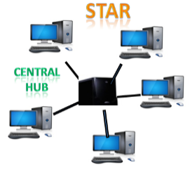
Network Topology..
Star Topology:
Star topology is the most popular topology in network implementation.
The devices are not directly linked to one another.
Star topology is an arrangement of the network in which each device has a dedicated point-to-point link only to a central controller called a Hub or Switch.

Slide 9
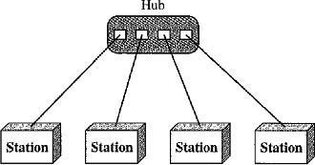
A star topology does not allow direct traffic between devices.
The central controller acts as an exchange.
Easy to install and reconfigure.
Less cabling is required
Star topology is robust, If one link fails, only that link is affected. All other links remain active.
If hub fails, entire processing will be stopped working.

Slide 10
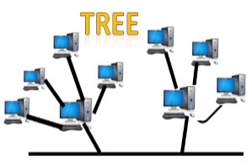
Network Topology..
Tree Topology:
Tree topology combines the characteristics of bus topology and star topology.
All the computers are connected with each other in hierarchical fashion.
The top-most node in tree topology is known as a root node, and all other nodes are the descendants of the root node.
There is only one path exists between two nodes for the data transmission. Thus, it forms a parent-child hierarchy.
Drawback:
Failure: A tree topology mainly relies on main bus cable and failure in main bus cable will damage the overall network.
Reconfiguration difficult: If new devices are added, then it becomes difficult to reconfigure.

Slide 11
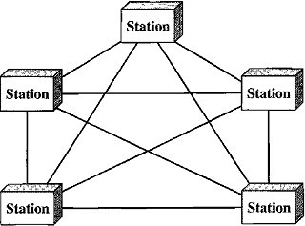
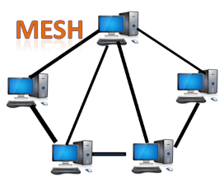
Network Topology..
Mesh Topology:
In a mesh topology, every device has a dedicated Point-to-Point link to every other device. (i.e.) for each node there is a link to all other nodes.
It does not contain the switch, hub or any central computer which acts as a central point of communication.
Mesh topology is mainly used for wireless networks and Internet is an example of the mesh topology.
Mesh topology is mainly used for WAN implementations where communication failures are a critical concern.
Mesh topology can be formed by using the formula: Number of cables = (n*(n-1))/2.
Types:
Full Mesh Topology
Partial Mesh Topology

Slide 12
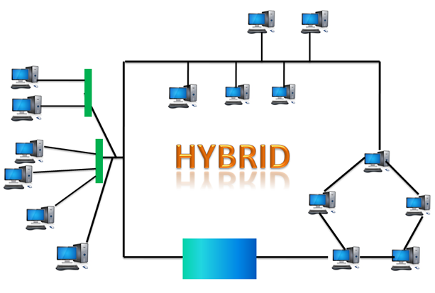
Network Topology..
Hybrid Topology:
The combination of various topologies is known as Hybrid topology.
When two or more different topologies are combined together is termed as Hybrid topology and if similar topologies are connected with each other will not result in Hybrid topology.
Example: if there exist a ring topology in one branch of ICICI bank and bus topology in another branch of ICICI bank, connecting these two topologies will result in Hybrid topology.
Drawbacks:
Complex Design
Costly Hub
Costly Infrastructure

Slide 13
SELF-ASSESSMENT QUESTIONS
Physical or logical arrangement of network is __________
Topology
Routing
Networking
Control
Which network topology requires a central controller or hub?
Star
Mesh
Ring
Mesh
3. A network comprising of multiple topologies is?
Complex
Hybrid
Bus
Star

Slide 14
SELF-ASSESSMENT QUESTIONS - Answers
Physical or logical arrangement of network is __________
Topology
Routing
Networking
Control
Which network topology requires a central controller or hub?
Star
Mesh
Ring
Mesh
3. A network comprising o multiple topologies is?
Complex
Hybrid
Bus
Star

Slide 15

Topic Summary
Network Topologies
Bus
Ring
Star
Tree
Mesh
Hybrid

Slide 16
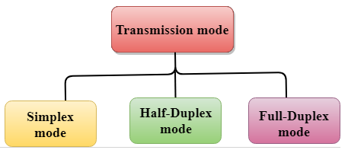
TRANSMISSION MODES
The way in which data is transmitted from one device to another device is known as Transmission mode.
Also called as Communication mode/Direction mode.
Transmission mode is defined in physical layer.

Slide 17

Transmission Modes.. Simplex Mode
In Simplex mode, the communication is unidirectional, i.e., the data flow in one direction.
A device can only send the data but cannot receive it or it can receive the data but cannot send the data.
Keyboard and Monitor are the examples of the simplex mode.

Slide 18
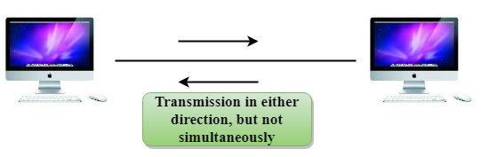
Transmission Modes.. Half-Duplex Mode
In a Half-duplex channel, direction can be reversed, i.e., the station can transmit and receive the data as well.
Messages flow in both the directions, but not at the same time.
A Walkie-talkie is an example of the Half-duplex mode. In Walkie-talkie, one party speaks, and another party listens. After a pause, the other speaks and first party listens. Speaking simultaneously will create the distorted sound which cannot be understood.

Slide 19
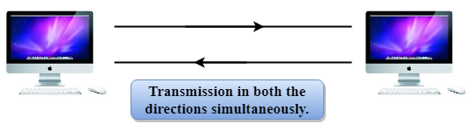
Transmission Modes.. Full-Duplex Mode
In Full duplex mode, the communication is bi-directional, i.e., the data flow in both the directions.
Both the stations can send and receive the message simultaneously.
Full-duplex mode has two simplex channels. One channel has traffic moving in one direction, and another channel has traffic flowing in the opposite direction.
The Full-duplex mode is the fastest mode of communication between devices.

Slide 20
Test your knowledge
WAN stands for __________ | a. World area network
 | b. Wide area network
 | c. Web area network
 | d. Web access network
Which topology uses a single cable which connects all the including nodes? | a. Star
 | b. Mesh
 | c. Ring
 | d. Bus
A term that defines the direction of flow of information between devices. | a. interconnectivity
 | b. intra connectivity
 | c. transmission mode
 | d. Communication

Slide 21
Test your knowledge…
WAN stands for __________ | a. World area network
 | b. Wide area network
 | c. Web area network
 | d. Web access network
Which topology uses a single cable that connects all the including nodes? | a. Hybrid
 | b. Mesh
 | c. Ring
 | d. Bus
A term that defines the direction of flow of information between devices is? | a. interconnectivity
 | b. intra connectivity
 | c. transmission mode
 | d. Communication

Slide 22
SUMMARY
Network Hardware Concepts
Network Topologies
Transmission modes

Slide 23
TERMINAL QUESTIONS
1. Illustrate different types of network topologies
2. Summarize the modes of data transmission.

Slide 24
REFERENCES FOR FURTHER LEARNING OF THE SESSION
Reference Books:
A.S. Tanenbaum, David J. Wetheral “Computer Networks” Pearson, 5th Edition.
Kurose, J and Ross, K Computer Networking: A Top-Down Approach Addison-Wesley- 6th edition.
Sites and Web links:
https://www.geeksforgeeks.org/types-of-transmission-technology/
https://www.tutorialspoint.com/data_communication_computer_network/computer_network_topologies.htm
3. https://www.javatpoint.com/computer-network-transmission-modes

Slide 25
THANK YOU
Team – Network Protocols & Security

